Slide 1

Note: The data and information in this document is reflective of a hypothetical situation and client. This document is to be used for KPMG Virtual Internship purposes only.
Sprocket Central Pty Ltd
Data analytics approach
[Division Name] - [Engagement Manager], [Senior Consultant], [Junior Consultant]

Slide 2
Note: The data and information in this document is reflective of a hypothetical situation and client. This document is to be used for KPMG Virtual Internship purposes only.
Agenda
Introduction
Data Exploration
Model Development
Interpretation

Slide 3
Note: The data and information in this document is reflective of a hypothetical situation and client. This document is to be used for KPMG Virtual Internship purposes only.
Introduction
Data Insight
This presentation aims at providing key insights into the company existing customers and recommending which of the 1000 new customers should be targeted to drive the most value for the organisation.
To achieve this with the help of the Company's existing customers dataset, we analysed the data through three phases, which are;
Data Exploration: At this phase we explore the existing customers dataset , to gain useful insight of the customers trends and behavior towards the company's products.. Our data exploration won't be based on just the customers demographics but rather focused more on the company's transaction. That is to say we would only be exploring the data of customers who have made atleast a purchase from the company.

Slide 4
Note: The data and information in this document is reflective of a hypothetical situation and client. This document is to be used for KPMG Virtual Internship purposes only.
Introduction
Data Insight
Data Modeling: We would be Modeling the dataset based on RFM analysis, so we can put the existing customers into segments and then explore the data of only the company's high value customers.
Interpretation: Without this phase in our data insight. Then all useful information, trends and behaviors as it relates to the existing customers can never be utilized. It is at this phase we target the company's new 1000 customers, who share same trends, behaviors and attributes with the existing high value customers, so it can help in driving maximum value for the company.

Slide 5
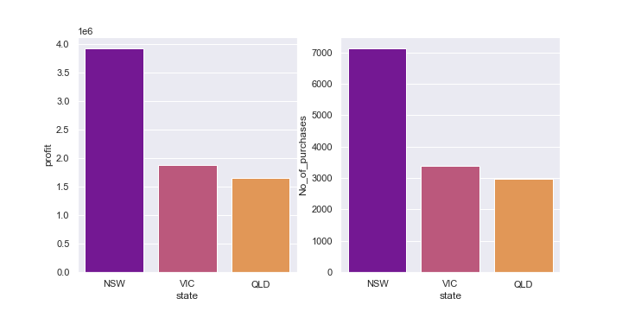
Note: The data and information in this document is reflective of a hypothetical situation and client. This document is to be used for KPMG Virtual Internship purposes only.
Data Exploration
Which State Did The Company Make more Sales and Profits ?
From Both charts we can see that New South Wales(NSW) makes more purchases from the company and also brings in more profit too.

Slide 6
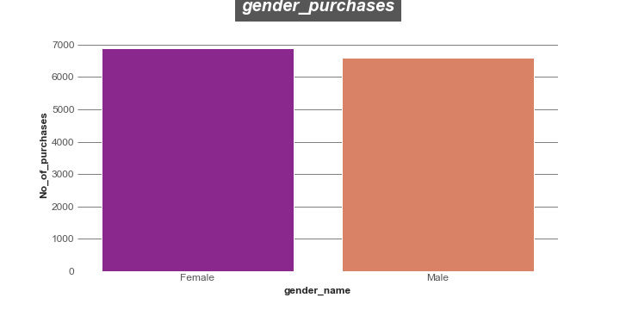
Note: The data and information in this document is reflective of a hypothetical situation and client. This document is to be used for KPMG Virtual Internship purposes only.
Data Exploration
How Each Gender Purchased From The Company.
It's a close call between the male customers and female customers. But as the chart shows that the female customers slightly edged out thier male counterparts in total number of purchases.

Slide 7
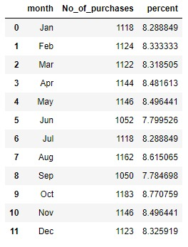
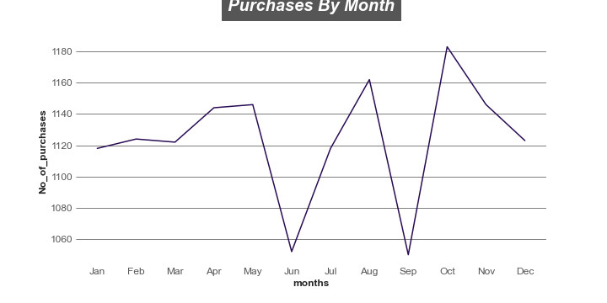
Note: The data and information in this document is reflective of a hypothetical situation and client. This document is to be used for KPMG Virtual Internship purposes only.
Data Exploration
Monthly Sales By The Company
For the year under review, all monthly purchases made by the customers fell below 8% twice through the year.
June and September saw major drop in the company sales.
October accounts for the most purchases made by customers.

Slide 8

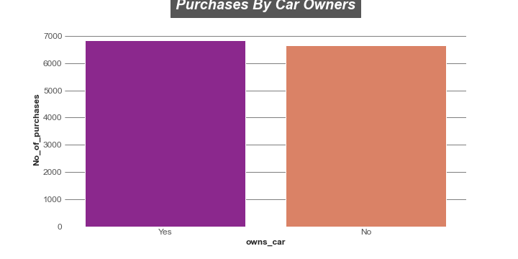
Note: The data and information in this document is reflective of a hypothetical situation and client. This document is to be used for KPMG Virtual Internship purposes only.
Data Exploration
How Purchases Were Made Based On
Car Ownership
One would have thought that customers who don't own cars would have made more purchases.
But a clear insight into our transaction data shows that not owning car didn't really influence purchasing more bicycles compared to those who own cars.
As we can seee that those who own cars slightly made more purchases than those who don't own cars

Slide 9
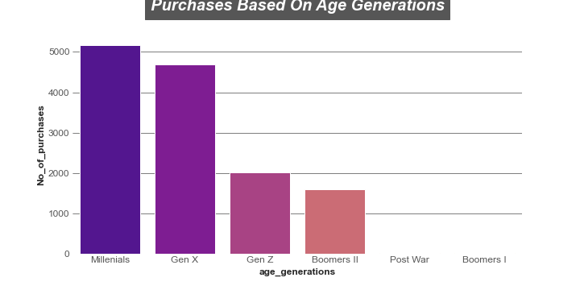
Note: The data and information in this document is reflective of a hypothetical situation and client. This document is to be used for KPMG Virtual Internship purposes only.
Data Exploration
How Each Age Generation Made Purchases
You can see appendix to get which age range falls under every age generation.
Millennials and Gen X customers made more purchases and accounts for over half of the total purchases made from the company.

Slide 10
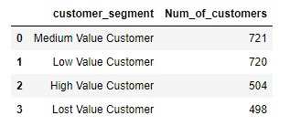
Note: The data and information in this document is reflective of a hypothetical situation and client. This document is to be used for KPMG Virtual Internship purposes only.
Model Development
Customer Segment With RFM Analysis
With the use of RFM analysis the company customers have been divided into segments.
Each segment representing the value they add to the company.
The High value customers are the important set of customers in every company, and we have about 504 customers that falls into this segment

Slide 11
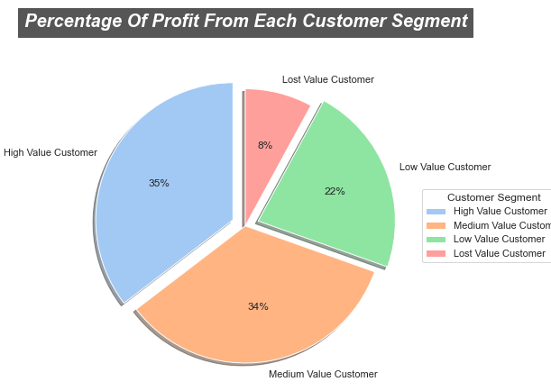
Note: The data and information in this document is reflective of a hypothetical situation and client. This document is to be used for KPMG Virtual Internship purposes only.
Model Development
Profit By Customer Segments
The pie chart shows that the company makes more profit from the high value customers, followed closely by the medium value customers.

Slide 12
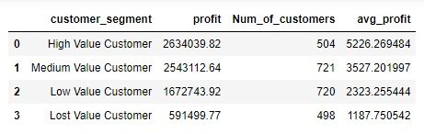
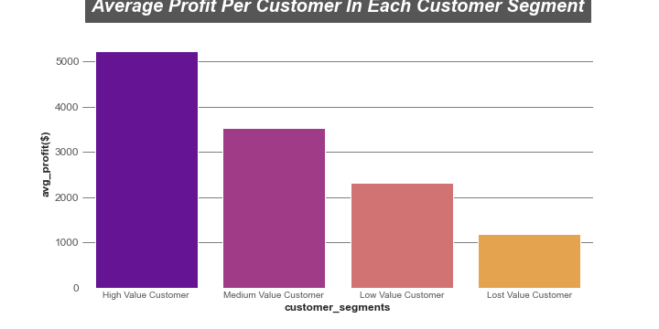
Note: The data and information in this document is reflective of a hypothetical situation and client. This document is to be used for KPMG Virtual Internship purposes only.
Model Development
Average Profit Per Customer In Every Customer Segment
In terms of the average profit every per customer in every segment. The high value customers is far much ahead, with approximately 5226 profit compared to other segments that falls largely below it.

Slide 13
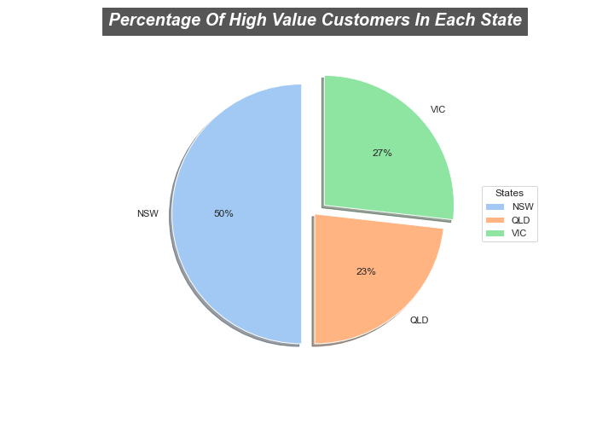
Note: The data and information in this document is reflective of a hypothetical situation and client. This document is to be used for KPMG Virtual Internship purposes only.
Model Development
State Representation Of The High Value Customers
The company's high value customers are spread unequally across three different states.
Majority of the high value are situated in NSW, about 50% of the high value customers to be precise.

Slide 14
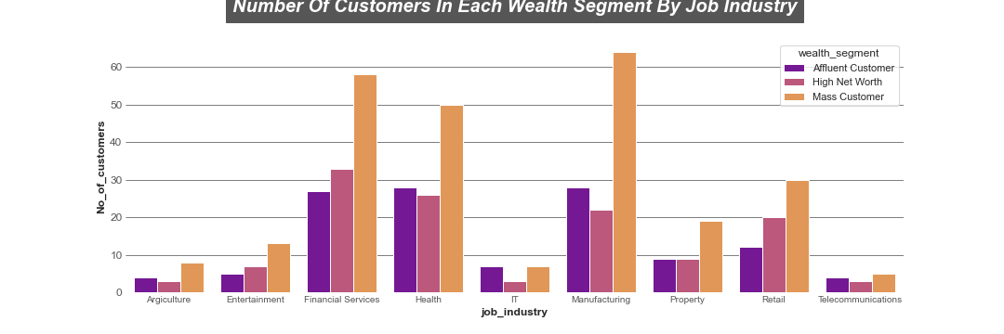
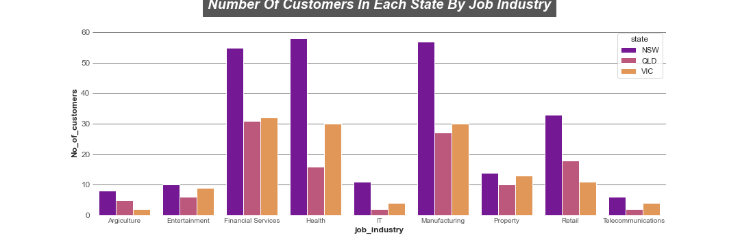
Note: The data and information in this document is reflective of a hypothetical situation and client. This document is to be used for KPMG Virtual Internship purposes only.
Model Development
The Job Industry With Most High Level Customers And How They Are Distributed In Each State And Wealth Segment.
Three Job industries accounts for most high value customers.
Financial Services, Health and Manufacturing, makes up these three job industries.
And across these three job industries we can also see with the top chart that most customers are from Mass Customers Wealth Segment, and the top chart shows that the majority of the customers reside in NSW.

Slide 15
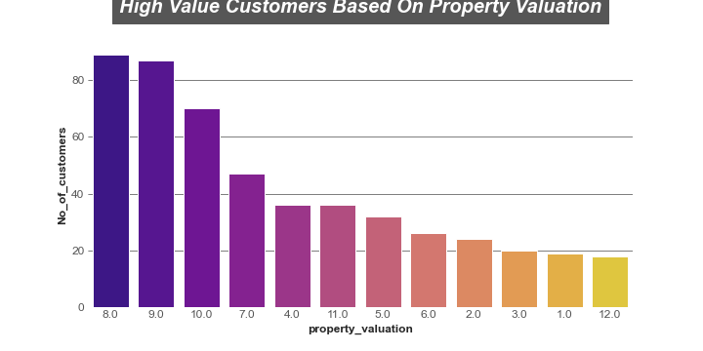
Note: The data and information in this document is reflective of a hypothetical situation and client. This document is to be used for KPMG Virtual Internship purposes only.
Model Development
Property Valuation And High Value Customers
The aim of this chart is to show the impact of property Valuation on the number of high value customers the company has.
Every Customer has a property Valuation between 1.0 to 12.0
The higher the number the better the customers property value.
With the chart we can see that customers with the highest property valuation(12.0) makes the bottom of the list in the number of high value customers.
Customers with property valuation of 8.0,9.0, and 10.0 tops the list of our high value customers.

Slide 16
Note: The data and information in this document is reflective of a hypothetical situation and client. This document is to be used for KPMG Virtual Internship purposes only.
Interpretation
Targeting Potential High Value Customers From The 1000 New Customers.
Based on the insight derived from our data, we can dedeuce certain qualities, trends and behaviors from our existing customers. So attempting to figure out potential high value customers, the new customers must meet certain requirements:
New customers that reside in New South Wales (NSW)
New customers from the Mass Customers Wealth Segment
New customers that have jobs in any of these three job industries (Financial Services, Health, and Manufacturing)
New customers with a property valuation of either 8.0, 9.0 and 10.0
The next slide shows why gender, car ownership and the last three years related bike purchases doesn't really count.

Slide 17


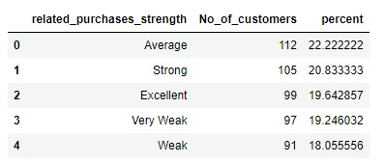
Note: The data and information in this document is reflective of a hypothetical situation and client. This document is to be used for KPMG Virtual Internship purposes only.
Interpretation
Why Gender, Car Ownership, And Last Three Years Bicycle Related Purchases Didn't Really Count
Based on all three customer attributes of the company high value customers .We can see that there isn't much difference between all categories. There's a less than 5% difference between the top and the bottom in them all.
That's why we can deduce that , be it male or female, or the customer owns a car or not, or even if the customer hasn't made an excellent purchase on Bicycle related items in the last three years. It doesn't really influence the high value customers that much.

Slide 18
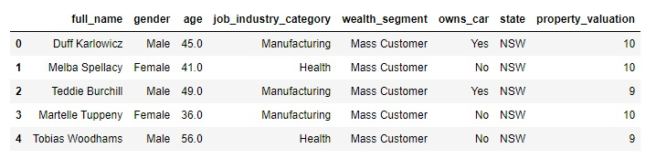
Note: The data and information in this document is reflective of a hypothetical situation and client. This document is to be used for KPMG Virtual Internship purposes only.
Interpretation
Targeted New Customers
There are 45 new Customers that meets all the requirements of our existing high value customers.Place
The table below is a snapshot of some of the potential high value customers.

Slide 19
Note: The data and information in this document is reflective of a hypothetical situation and client. This document is to be used for KPMG Virtual Internship purposes only.
Appendix

Slide 20
Note: The data and information in this document is reflective of a hypothetical situation and client. This document is to be used for KPMG Virtual Internship purposes only.
Appendix
Age Generations Past Three Years Bicycle Related Purchase strength
Age - Generation 3 Years Bicycle related Purchases --- Related Bicycle Purchases strength
9 - 24 Gen Z 80 - 99 Excellent
25 - 40 Millennials 60 - 79 Strong
41 - 56 Gen X 40 - 59 Average
57 - 66 Boomers II 20 - 39 Weak
67 - 75 Boomers I 0 - 19 Very Weak
76 - 93 Post War

